Slide 1


Student Management System
Bermuda
Team & Roles:
Nabeel(TL) - Development
Dheeraj - Development
Rohit - Development and Non-technical
Srikavya - Non technical
Pranathi - Non technical
Mini Project

Slide 2
About the project
Student management system is a database management system which allows the user to store student information in a query structured database.
The users of this system are mainly school/college management.
This system allows the users to add, delete and modify student record accordingly.
The project is built using sqlite3 module in python using PyCharm IDE.
Student information is stored in a .db format file which can be accessed using any database file viewer.
The system also allows the user to view the complete record and as well as to view data according to a class.

Slide 3
Key Takeaways from Project
Effectively and conveniently manage student record.
Flexibility to manage the student details and modify them whenever necessary.
Ability to view student data class/section wise.
Easy to use.

Slide 4
User Stories:
Schools and colleges require a medium to store a record of students along with their details
Hence it becomes mandatory to maintain a student database management system
Allowing the user with flexible options like adding, deleting, modifying a record in the database will make the task more convenient.

Slide 5
User Tasks
The user is supposed to use an interface to manage the database.
The interface allows user to:
View the complete student record
Search a student record by any attribute
Add an entry to the record
Delete an entry from the record
Modify an entry from the record

Slide 6
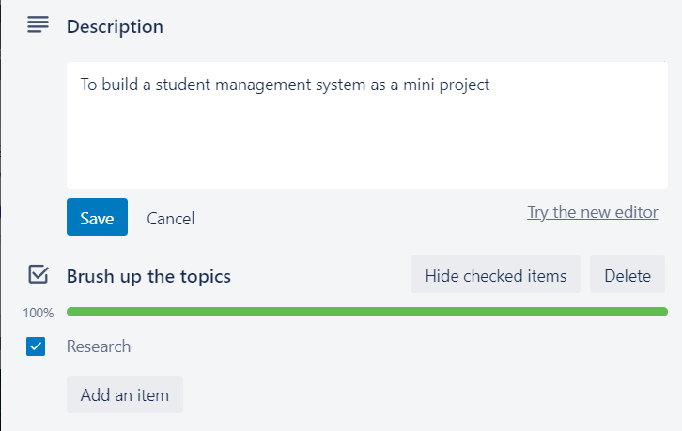
Trello History

Slide 7
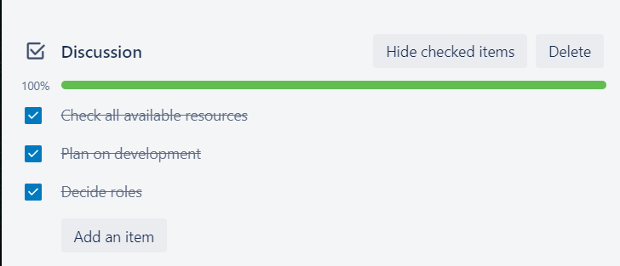

Slide 8
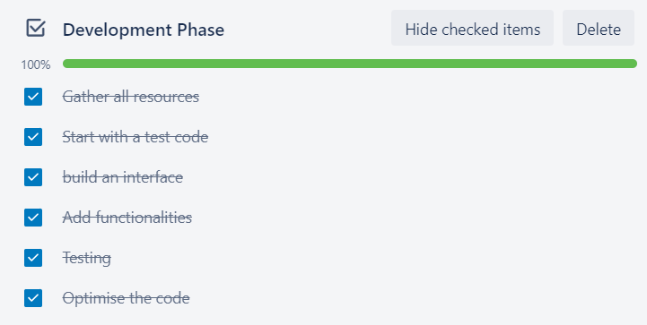

Slide 9
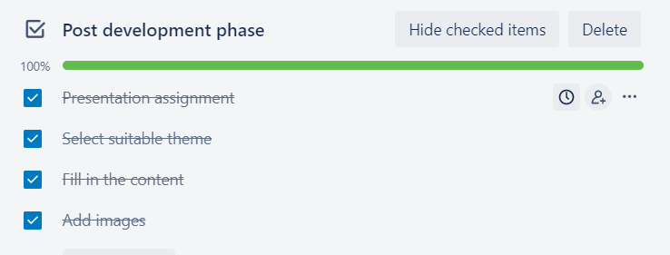

Slide 10
Implemetation
Sqlite3 module to connect with a database
Creating attributes on student details
Simple conditional statement to create a working interface
Simple function calls to define functionalities
Finally adding the functionalities: Add, Delete, Modify and view record.

Slide 11
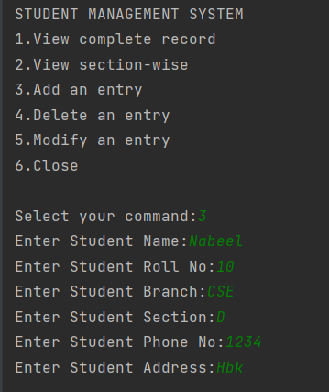
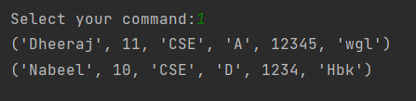
Testing

Slide 12
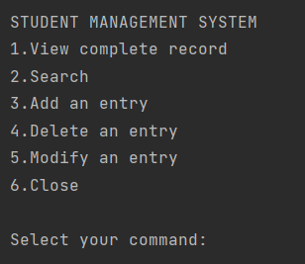
Project Demo

Slide 13
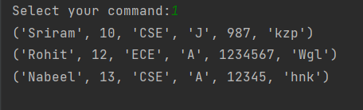
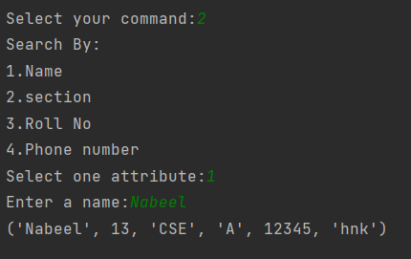

Slide 14

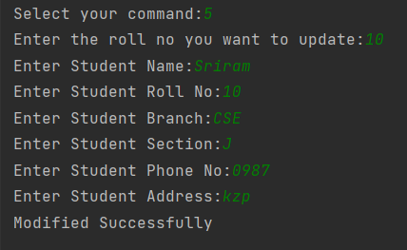

Slide 15
Retrospective Meet
Every command used while developing worked completely fine.
The project can be further developed into an interactable window using Tkinter module.
More functionalities can be added like only login access to the database and database being password protected using a NoSQL database program like MongoDB.

Slide 16
Thank
You

